Slide 1
Intervening in Vicious Circles: developing co-op skills and co-op enterprises for transition from prison Dr. Judith Harris Urban & Inner-City Studies University of Winnipeg
Our Core Think Tank Team:
Melody Stevenson, Colleen Coulter, Alice Zador, Holly Enns, Justin Rivard, Kathleen Venema, Kevin Settee, Ashley Howard, Kate Kent
Notes:
When I took the Inside-Out training in 2011, I convinced out team to design an outline on Co-operative Enterprise.
They were kind enough to jump in. I think that was the initial encouragement I needed to

Slide 2
The Current situation in Manitoba:
Incarceration rate: 243/100K is 3X Canadian rate
Missing & Murdered women: of female homicides in Manitoba, 49% were Aboriginal women (yet 12% pop.)
Apprehended by Child and Family services: 1 in 5 children (0-4 years) in North End Winnipeg

Slide 3
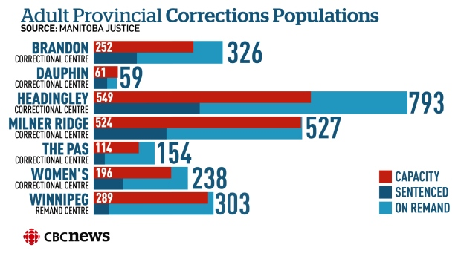
“Manitoba jails bursting at the seams even though crime rates continue to fall. Jail guard among fastest-growing occupations within the provincial public service By J. Marcoux, C. Barghout, CBC News Posted: Oct 29, 2015.
Notes:
Under the former Conservative government, the numbers in Canadian prison escalated due to: mandatory minimum sentences; changes in parole eligibility, barriers to pardons and cuts in rehabilitation programs.
The occupancy rate is 127%.
The rate of solitary confinement at Manitoba prisons is 1 in 10 – the highest rate in Canada

Slide 4
Winnipeg’s Violent Streets ( M. Pearce, 2013) Downtown Winnipeg: blue = missing, red = deaths)
In last 50 years in Manitoba there were:
111 missing or murdered women
83 of those murdered were Aboriginal
28 are missing women
18 missing in last 10 yrs
10 murdered were children (age 11 & under)
20 is the average age of the missing and murdered women
6 women were murdered by their husband or boyfriend
Notes:
Drag the Red River is a group that was formed after 15 year old Tina Fontaine’s death in 2014.
Its an organization that searches for bodies dumped in the Red River.
Bodies are retrieved at a rate of about 7 each year.

Slide 5
North End Neighbourhoods Need
Access to Education
Notes:
The railway yards in Winnipeg separate the North End from the rest of Winnipeg.
Indigenous peoples make up about a third of the population.
The avergae number of people with no certificate, diploma or degree is close to 50% compared to 20% at the City level.

Slide 6
Vicious Circles are Intergenerational
These figures explain factors behind vicious circles of intergenerational poverty and incarceration
Indigenous women comprise more than 85 percent of admissions of women in jails in Manitoba. Indigenous adults represent only twelve percent of the provincial population (Elizabeth Fry Society 2011).
Women who populate the Women’s Correctional Centre (WCC) are there because of crimes of poverty
Studies indicate that “a higher proportion of incarcerated Aboriginal women than incarcerated non-Aboriginal women are separated from their children”. Eljdupovic & Bromwich (2013, pp.45-46)

Slide 7
Walls to Bridges is a Vision for Winnipeg & Manitoba
Manitoba’s Walls to Bridges
intervening in vicious, intergenerational circles of poverty and violence
Creating circles of safety for families and children
The Approach:
I-O principles, Freirian approach & Indigenous pedagogy
Emphasizing Dewey’s principles of Interaction & Continuity
Future: Manitoba-wide W2B program:
responding to the need for education at WCC, Headingley (men’s Provincial) Stony Mountain (men’s Federal)
Teaching and developing co-operatives, will increase employment, and improve integration
Notes:
When I came back to Winnipeg after the inside-out training and explained the program to Larry Morrisette, and cultural advisor in Manitoba, he pushed me to explore ways of establishing a program in Winnipeg. Shoshana Pollack and Simone Davis were organizing a hub in Waterloo, On.
Simone presented on the new Walls to Bridges program on a number of visits to Winnipeg.

Slide 8
We all know that Education Changes Lives
“Walls to Bridges took our moments of grey and gave us colours of hope” (an Inside student, WCC 2016 now enrolled at University of Winnipeg)
Education is a human right “this right is defended by appeal to education as a means to an end and as a human right − required by respect for persons and their human dignity.” (J. Vorhaus, London Review of Education 2014)
The education experience, “if it arouses curiosity, strengthens initiative and sets up desires and purposes, will carry a person over dead places in the future” (J. Dewey, 1938, p. 38)
Notes:
A few quotations
Human dignity and human rights- including the right to education don’t end at the prison entrance.
Dewey describes experiential learning as a powerful tool that will students carry with them into the future

Slide 9
Dewey’s lecture on Education & Experience (1938)
Dewey highlighted two principles:
continuous learning must be in accordance with the learner’s present and expected future situation
interactions with a teacher, peers, and pedagogically generative artifacts and phenomena, link the past to the future
Dewey claimed that education is intimately connected to “social purpose” and “democracy”

Slide 10
Dewey’s Principle of Interaction & W2B/I-O
The interactions among W2B/I-O students and between students and instructor in a learning circle are equalised & generate trust.
Often its “collateral learning in the way of formation of enduring attitudes, of likes and dislikes that is most important”(Dewey 1938)
W2B/I-O classes, that prioritise interaction and focus on social justice issues, present an opportunity to consider the structural factors that have predetermined the student’s path into prison.
Students reflect on realities that explain events that came under their control and what was the consequence of wider forces
Helps them to come to terms with the present & plan for the future.

Slide 11
UIC- 2001: COMMUNITY DEVELOPMENT AND CO-OP ALTERNATIVES

Slide 12
Community Development & Co-operative Alternatives (UIC 2001)
8 inside students and 8 outside students at Women’s Correctional Centre and 24 students at Elizabeth Fry Society MB
We meet in a circle and open with a traditional smudge
The course provides a critique of Capitalism and presents Community-Based Development as an alternative.
Students learn fundamentals of co-op structures & concepts
Student Groups design Co-op business plans
Co-op developers advise student groups
An Introduction to co-ops and to potential work in Winnipeg
Transition into university: 4 students continuing at UW 2017
Supports at UW: Aboriginal Student Services Centre, Road Map
An emerging Think Tank
Notes:
Co-op fundamentals: reciprocity, social capital, pooling resources,

Slide 13
W2B/I-O AND CO-OP VALUES
Co-op education highlights values and points to opportunities for those who face an uncertain economic environment
Co-op values of self-help, self-responsibility, and solidarity are underscored in classic readings in the orientation of W2B/I-O classes:
Palmer (2004) reminds us that a circle of trust provides space where we confront and correct ourselves by listening to our inner teacher and Little Bear (2000) emphasizes relationship and reciprocity.
The first half of the course provides a critique of capitalism and presents community-based development as an alternative.
Collaborative problem solving plants seeds of social capital among the students.
The second half of the course shifts into fundamentals of co-op concepts and structures, focused on 2 co-op booklets

Slide 14
Co-op Booklet 1: Table of Contents
What we know about the economy - p. 3
Whole Economy Model - p. 3
Leakey Bucket - p.4
Statements: popular version - p. 5
Statements: economic version - p. 6
Why are CD principles important – p. 7
Co-op Stories with handouts – p.8
What is a co-op – p. 9
Why form a co-op – p.10
Examples of co-ops – p. 11
Co-ops and Traditional Values – p. 12
Mondragon Principles – p. 13-14
Rochdale – p. 15
The Antigonish movement – p. 16-18
Types of Co-ops – p. 19-24
Triple Bottom Line in Action – p. 25
Co-ops vs other business – p. 26-27
V. Vint (Aboriginal Designers Co-op) – p. 28
Steps in Starting a Co-op – p. 29-30
Factors that make Co-ops Work – p. 31-
Reciprocity – p. 31-32
Economic Rent - p. 33
Pooling Resources – p. 34
Where to find more information – p. 35

Slide 15
Co-op Booklet 2: Table of Contents
Business Structures - p. 3 – 4
The Co-op Model – p. 5
Types of Co-ops– p.6 -7
Examples
Co-op Organizational Chart – p. 8 - 9
Roles and relations
Legal Matters – p. 10- 11
The Co-op Act
Maintaining records
Financing & Sources of Capital– p. 12-13
Board of Directors– p. 14
Treasurer, Secretary, General Manager – p. 15
Leadership: You’re the Boss – p. 18-19
Training Requirements– p. 17-18
Articles of Incorporation – p. 19-20
Shares in the Co-op – p. 21
By-laws & Membership – p. 22
Social Co-ops - p. 23
Changing economic landscape - p. 24
Vertical vs horizontal positioning - p. 25
Barriers to employment - p. 26
What is a Social Co-op? – p. 27
Italian Social Co-ops - p. 28
Social Co-ops in Canada – p. 35
Quebec Solidarity Co-ops – p.

Slide 16
CO-OPS AND CONTINUITY
The classes at the WCC, run “technology-free”—we require a level playing field for inside and outside students
We bring in two types of resources: co-op advisors and materials for the construction of business plans in the form of “Zines”.
The group assignment is to develop a business plan for a co-op.
Co-op advisors visit on two occasions to present on their own co-op history and then sit with the groups individually to answer questions and advise.
Our ultimate vision is that some of the co-op business plans eventually become realistic enterprises.

Slide 17
Outside Students at WCC after graduation

Slide 18
2017: CREATING THE WINNIPEG W2B WEB:
OUR VISION OF THINK TANKS

Slide 19
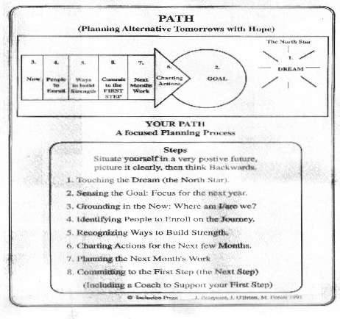
THE PATH PROCESS PEARPOINT, O’BRIEN & FOREST

Slide 20
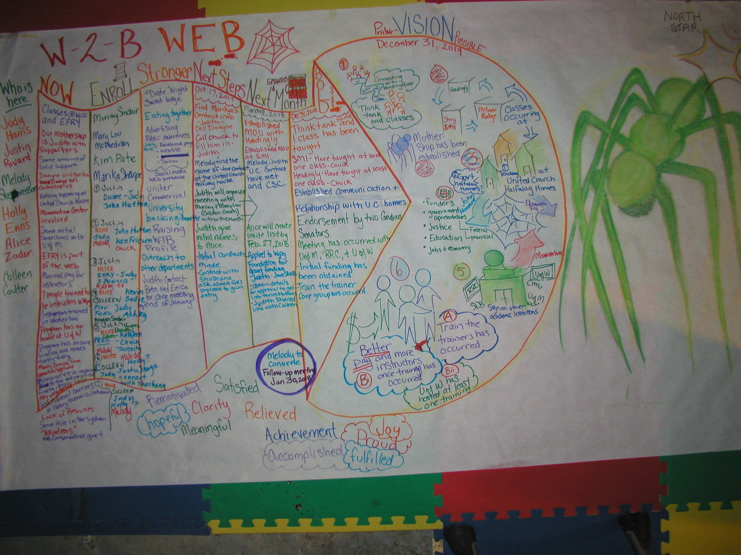

Slide 21
North Star: Create the W2B Web to support Justice-involved men & women
The north star guides the program and points to avenues for graduating students who understand the correctional system and what it implies about social justice in Canada.
A mother ship that does long-term planning of a humanized system. Eight autonomous chapters: WCC, Headingley, Stony, Brandon, Milner Ridge, EFRY, John Howard, Half-way House and Brandon.
As we work towards that brighter star of abolishing prisons, we understand that think tanks, once they are seen as the cultural norm of the Winnipeg justice system, can advance understanding beyond a binary of “us and them”.

Slide 22
Positive and Possible Vision: Seven Goals Advanced by Dec. 31, 2019
GOAL 1: W2BWPG has connected with Winding River Range at the men’s facility Headingley to establish a think tank and classes are running annually.
GOAL 2: W2BWPG classes are occurring at Stony Mountain
GOAL 3: A web of partnerships has been created, including eight Think Tank chapters
GOAL 4: Core Funding structure is part of the web
GOAL 5: Eight Post-secondary Institutions represented in mother ship: Universities of Winnipeg, Manitoba, Brandon, Red River College, Assiniboine College, University of the North, and Canadian Mennonite University.
GOAL 6: Walls-to Bridges Collective in Waterloo has offered/completed training of trainers course for Winnipeg instructors. One course offered for local faculty.
GOAL 7: W2BWPG “mother ship”& “spider’s web” has been established.

Slide 23
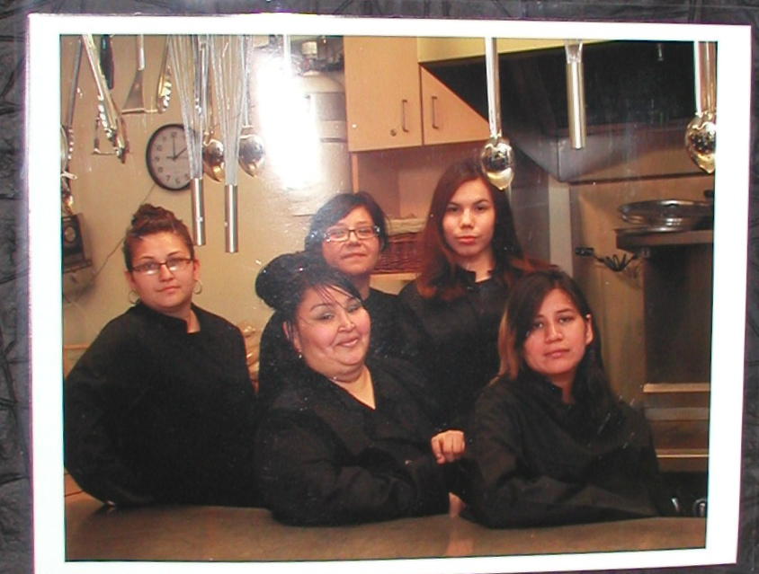
THINK TANKS AS SOCIAL CO-OP DEVELOPERS? “promoting continuity” (Dewey)
Eagle Women’s Lodge Catering Cooperative

Slide 24
More information on W2B in Winnipeg
W2B Winnipeg:
Judith Harris (Urban & Inner-City Studies U of W 988-7537)
Kathleen Venema (English U of W 786-9333)
Melody Stevenson (Momentum Centre 380-9288)

