Slide 1
Building Programs, Expanding Networks
How do we collaborate to grow Inside-Out?
Facilitators: Joanne Carroll and Judith Ryder
St. John’s University Queens, N.Y.

Slide 2
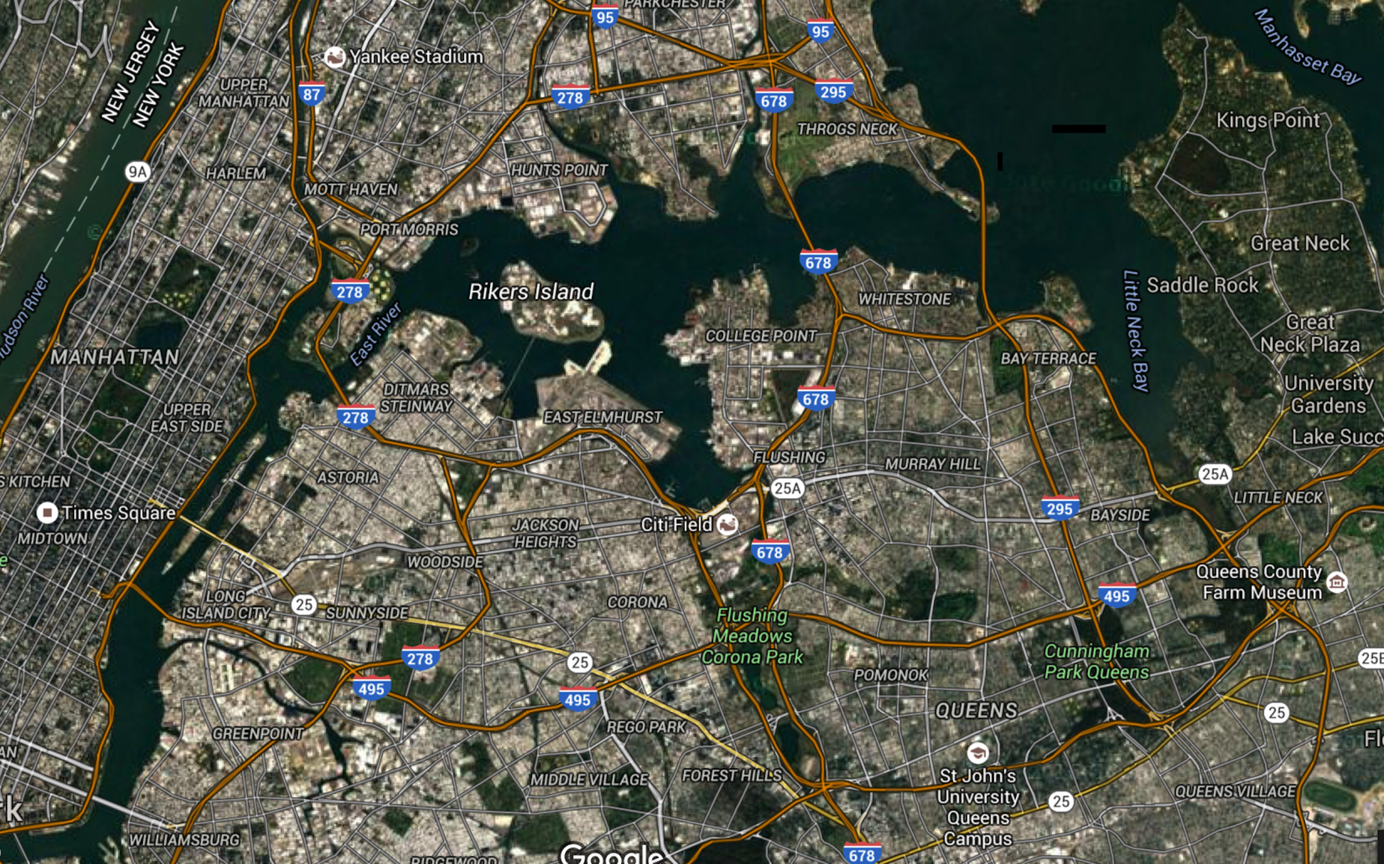
New York City

Slide 3
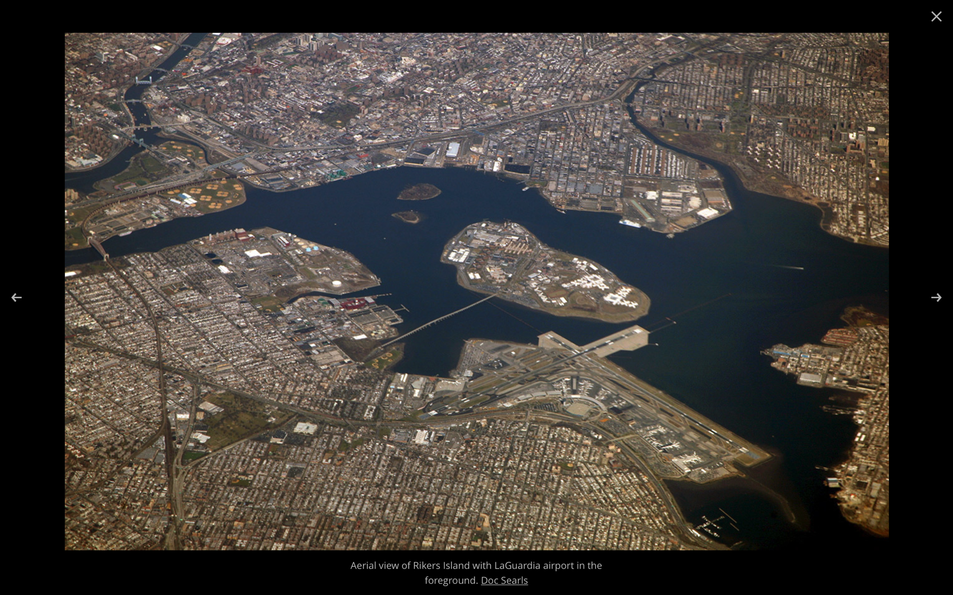
Rikers Island and La Guardia Airport

Slide 4
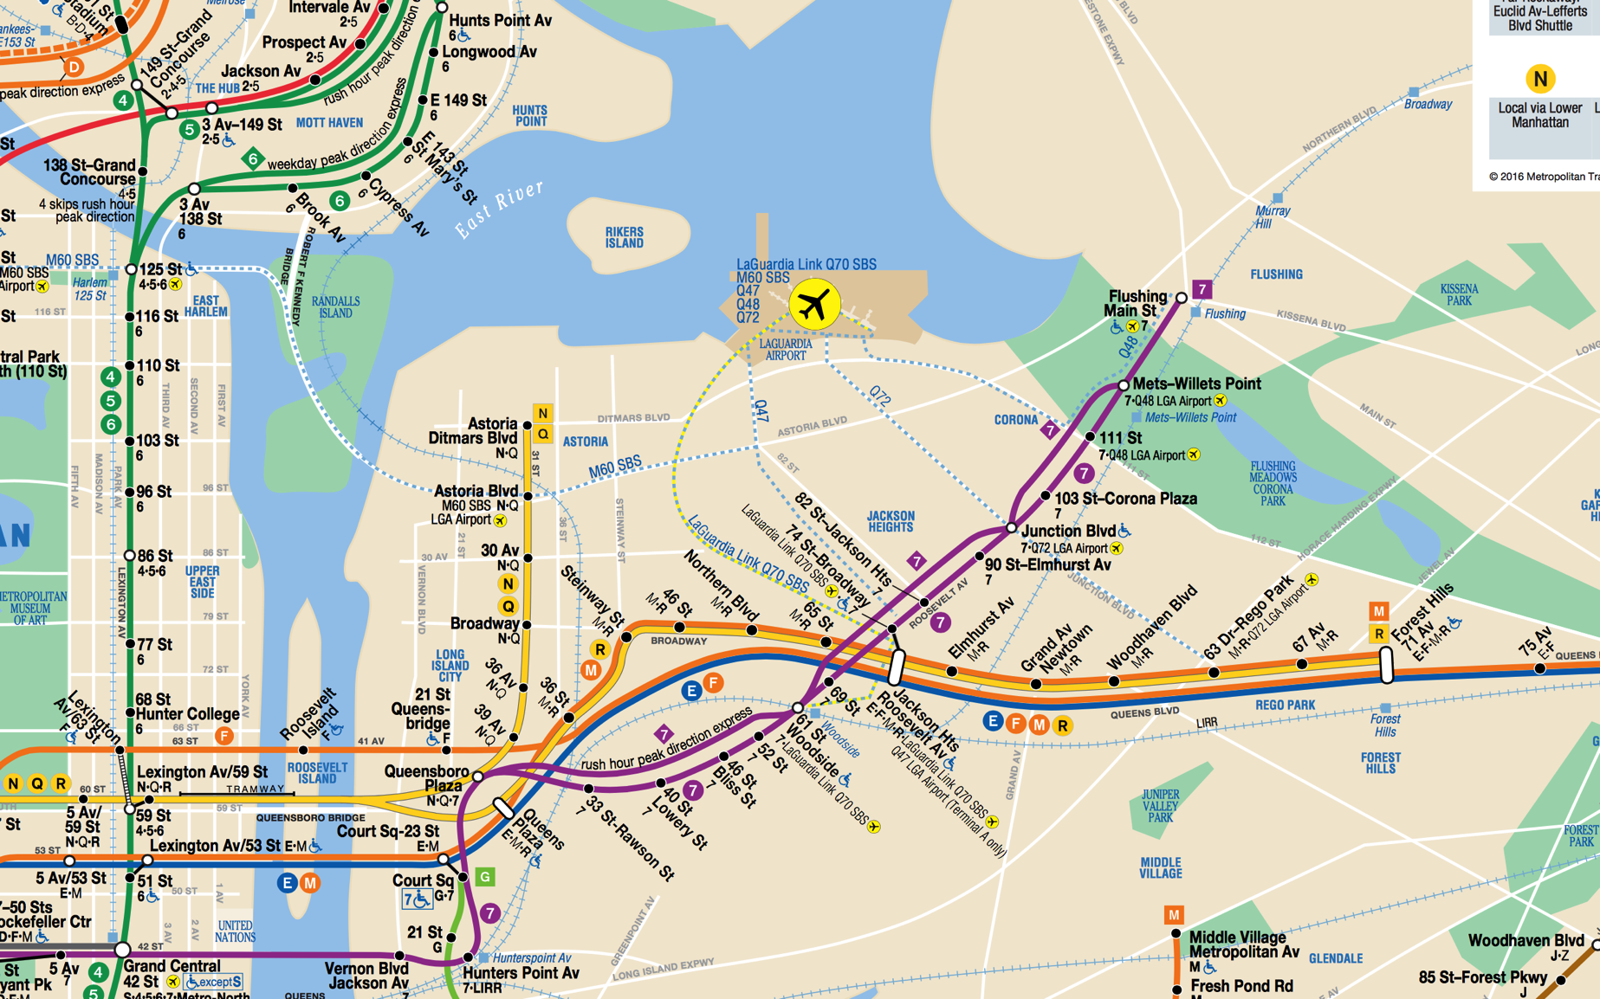
NYC Subway/Bus Map

Slide 5
St. John’s University
Who we are, where we are, what we do
Two faculty currently trained in I-O pedagogy
University located in Queens, N.Y.
Proximity to Riker’s Island Correctional Facility (jail)
Starting 3rd year of partnership with Riker’s
Sociology class: Crime and Justice Behind the Walls
All students earn college credits
University provides transportation

Slide 6
Challenges/Limitations
Short term population at jail
Emphasis on vocational training and job placement post incarceration at correctional facilities
University financial concerns with expansion
Competition from other colleges/universities

Slide 7
Plans for growing SJU program
Internal expansion: Contemporary Issues in Public Health
  Anticipated Spring 2018
Networking with other area colleges and universities
  Complementary programs: fuller array of services to offer
  Link Riker’s population to prisons upstate
  SFC part of Hudson Link post prison education
Post prison programs
  College readiness summer program at the university
  Scholarships upon release to continue education
  Articulation with community colleges

Slide 8
New York State: Higher Education and Prison System
Facilitating educational opportunities for incarcerated students

Slide 10
Model Collaborative:
Hudson Link for Higher Education
College partners: Columbia University, Mercy College, Nyack College, Siena College, SUNY Sullivan (CC), SUNY Ulster (CC), Vassar College
Correctional Facilities: Greene, Fishkill, Shawangunk, Sing Sing, Sullivan, Bedford Hills (Women)
Post-prison education: Nyack College and St. Francis College
Reentry Services: College and Community Fellowship, Osborne Society, Exodus, Center for Employment Opportunities, Fortune Society, Career Gear, Bottomless Closet

Slide 11
QUESTIONS FOR DISCUSSION
Does your current program include or do you envision multidisciplinary course offerings?
Are Inside students able to earn credit or a degree after taking courses in your program?
How many faculty teach the course offerings in the I-O program at your institution?
Do you directly collaborate with other departments or with other institutions?
What institutional barriers have you encountered or do you anticipate that may interfere with expanding the I-O Program at your institution?
What successful strategies have been utilized to expand the range of courses offered?
Are there possible collaborators within your institution who teach or are interested in teaching an I-O course? Are there any institutional barriers to recruiting new faculty?
What barriers exist in developing intercollegiate consortia; how might these be overcome?
Are correctional institutions you partner with eager to expand the I-O program; are there logistical limitations for them?
Do partner with more than one correctional facility; is this part of the future development of your program?

